Slide 1

Secured Wi-Fi Enabled USB Flash Drive
University of Dar es Salaam
Student’s name: | Kowero, Walidi Waziri
Registration No: | 2020-04-04390
Degree Programme: | B.Sc. Electronics Engineering
Supervisor: | Prof. Baraka Maiseli
Electronics and Telecommunications Engineering
ES 499: Final Year Project
01

Slide 2

Outline
University of Dar es Salaam
Introduction
The Existing System
Weaknesses of the current system
Main objective of the project
Comment table
Specific objectives
Scope of the Project
Methodology
System Requirements
System Design
Project timeline
Work done so far
Electronics and Telecommunications Engineering
ES 499: Final Year Project
02

Slide 3
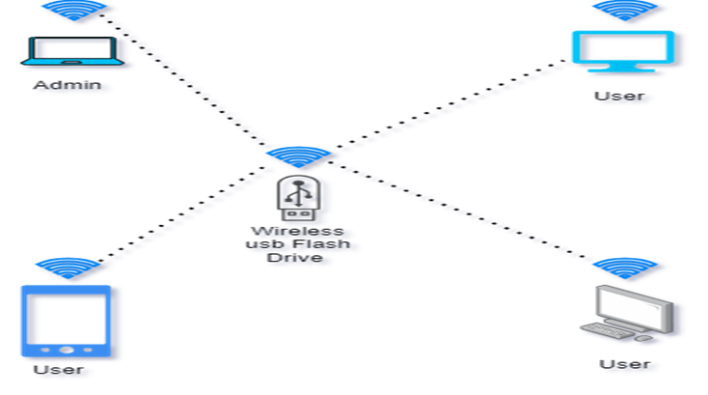
Introduction
University of Dar es Salaam
This project aim at increasing mobility and flexibility by using the 2.4GHz radio technology and Wi-Fi protocols to improve ways to securely transfer data across devices.
Electronics and Telecommunications Engineering
ES 499: Final Year Project
03

Slide 4
Problem statement
University of Dar es Salaam
Users using edge-devices face a hard time in data storage and ways of data sharing.
The existing ways limits user to one of the way to which he or she can share data.
Most local users who use wired devices like usb flash disk, external hard drive have to physically share their storage devices to share even a small document.
We have to come up with a way to combat this inconvenience.
Electronics and Telecommunications Engineering
ES 499: Final Year Project
03

Slide 5
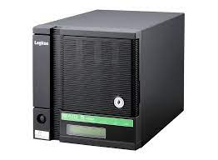
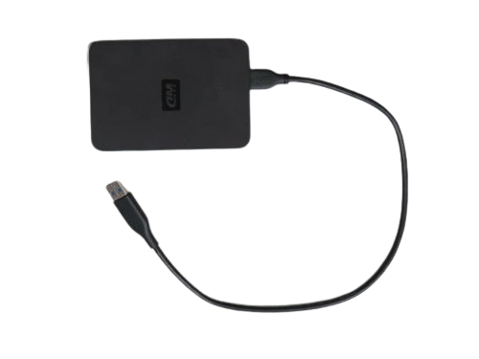
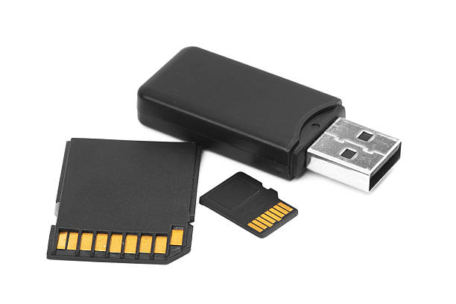
The existing system
University of Dar es Salaam
Most of the existing wireless USB flash drive uses middleware to perform data transfer and provides single way to access data
Electronics and Telecommunications Engineering
ES 499: Final Year Project
04

Slide 6
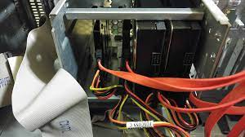
Weakness of the existing system
University of Dar es Salaam
Lack of suitable design of storage devices to suits the local markets needs.
Few and inconvenient ways of sharing files
Unreliable data security.
Electronics and Telecommunications Engineering
ES 499: Final Year Project
05

Slide 7
Comment Table
University of Dar es Salaam
Comment from last presentation | Implementation of the comment | Where shown
To reduce the scope on the term “wireless” | Reduced the title to “Secure Wi-Fi enabled USB flash drive” | At project title
To refine the objectives | Objectives have been changed | Not shown in the report yet.
To be precise on the mode of operation of the system | Adding flowchart and use case diagrams | From page number 8 to 15 of the report.
Electronics and Telecommunications Engineering
ES 499: Final Year Project
06

Slide 8
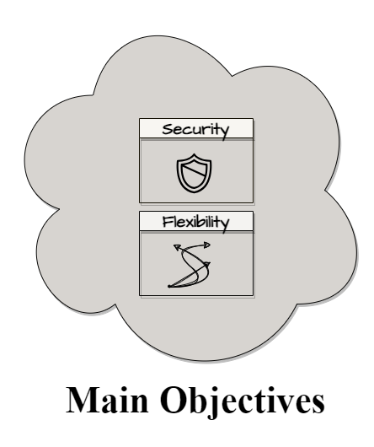
Main objective
University of Dar es Salaam
To enhance flexibility and security in wireless flash storage devices.
Electronics and Telecommunications Engineering
ES 499: Final Year Project
07

Slide 9
Specific objectives
University of Dar es Salaam
To establish system requirement for wireless data transfer
To implement secure ways of data transfer wirelessly
To implement multipoint user-friendly interfaces
Electronics and Telecommunications Engineering
ES 499: Final Year Project
08

Slide 10

Scope of the project
University of Dar es Salaam
Local individuals using edge devices and personal computers.
Local companies and Institutes
Electronics and Telecommunications Engineering
ES 499: Final Year Project
09

Slide 11
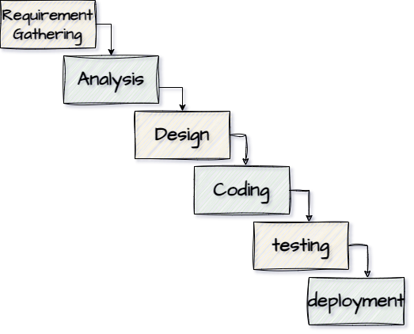
Methodology
University of Dar es Salaam
Electronics and Telecommunications Engineering
ES 499: Final Year Project
10

Slide 12
System requirements: Functional Requirements
University of Dar es Salaam
Read/Write File
Wireless Access
Wired/USB Mode
Multi-device Access
Remote Management
Electronics and Telecommunications Engineering
ES 499: Final Year Project
11

Slide 13
System requirements: Non-Functional Requirement
University of Dar es Salaam
Low Power Consumption
High data Transfer Speed
Response Time
Data integrity
Cross-Platform Compatibility
Electronics and Telecommunications Engineering
ES 499: Final Year Project
12

Slide 14
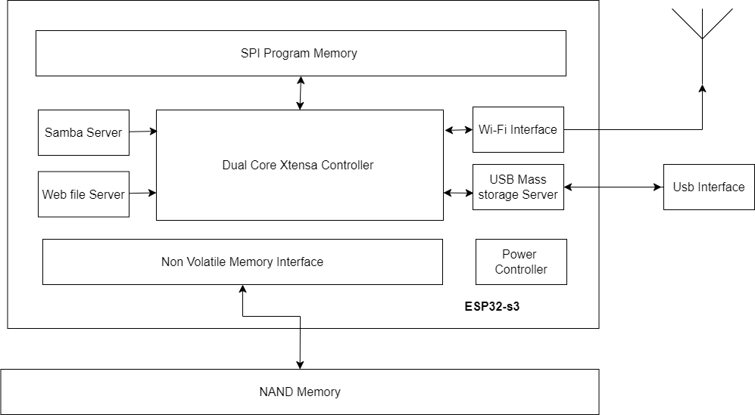
System Design: Block diagram
University of Dar es Salaam
Electronics and Telecommunications Engineering
ES 499: Final Year Project
13

Slide 15
System Design : Flowchart
University of Dar es Salaam
Start
Enabling Wi-Fi Access Point
Mass Storage Server
SMB Server
Web File Server
Error Handling
Serve Forever
NO
If error
YES
Electronics and Telecommunications Engineering
ES 499: Final Year Project
14

Slide 16
System Design : Use case
University of Dar es Salaam
Anonymous User
Initiating device
Authentication
Shared Folder Access
Admin
Remote access
Usb interfaces
Turning off device
File manager interface
Configuration
Security details and configurations
system
Electronics and Telecommunications Engineering
ES 499: Final Year Project
15

Slide 17
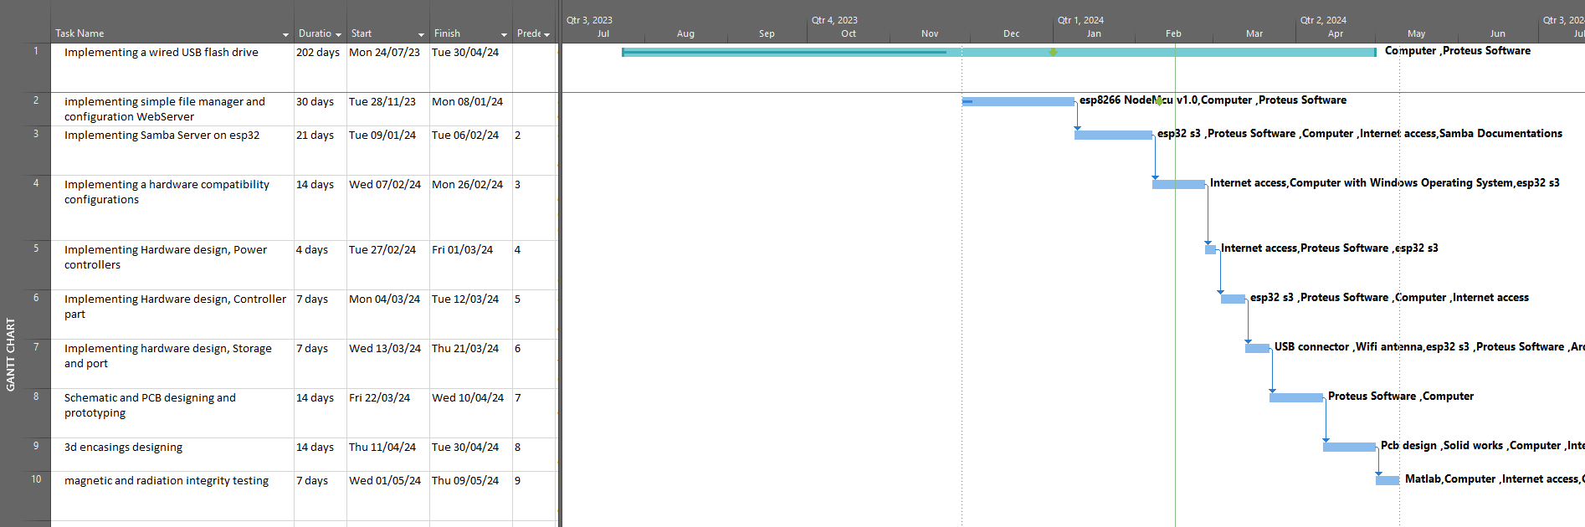
Project timeline
University of Dar es Salaam
Electronics and Telecommunications Engineering
ES 499: Final Year Project
16

Slide 18
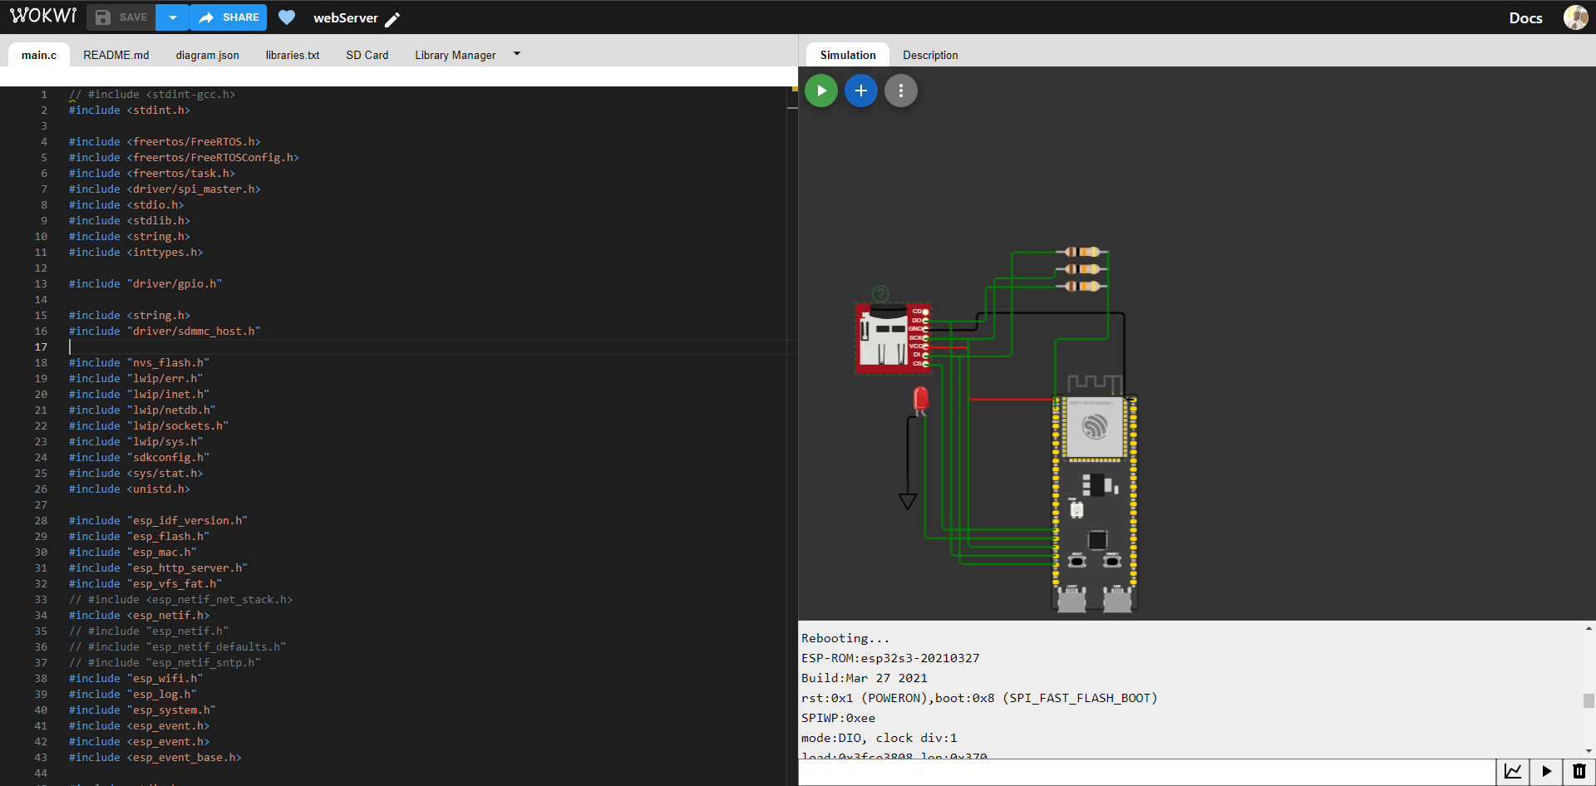
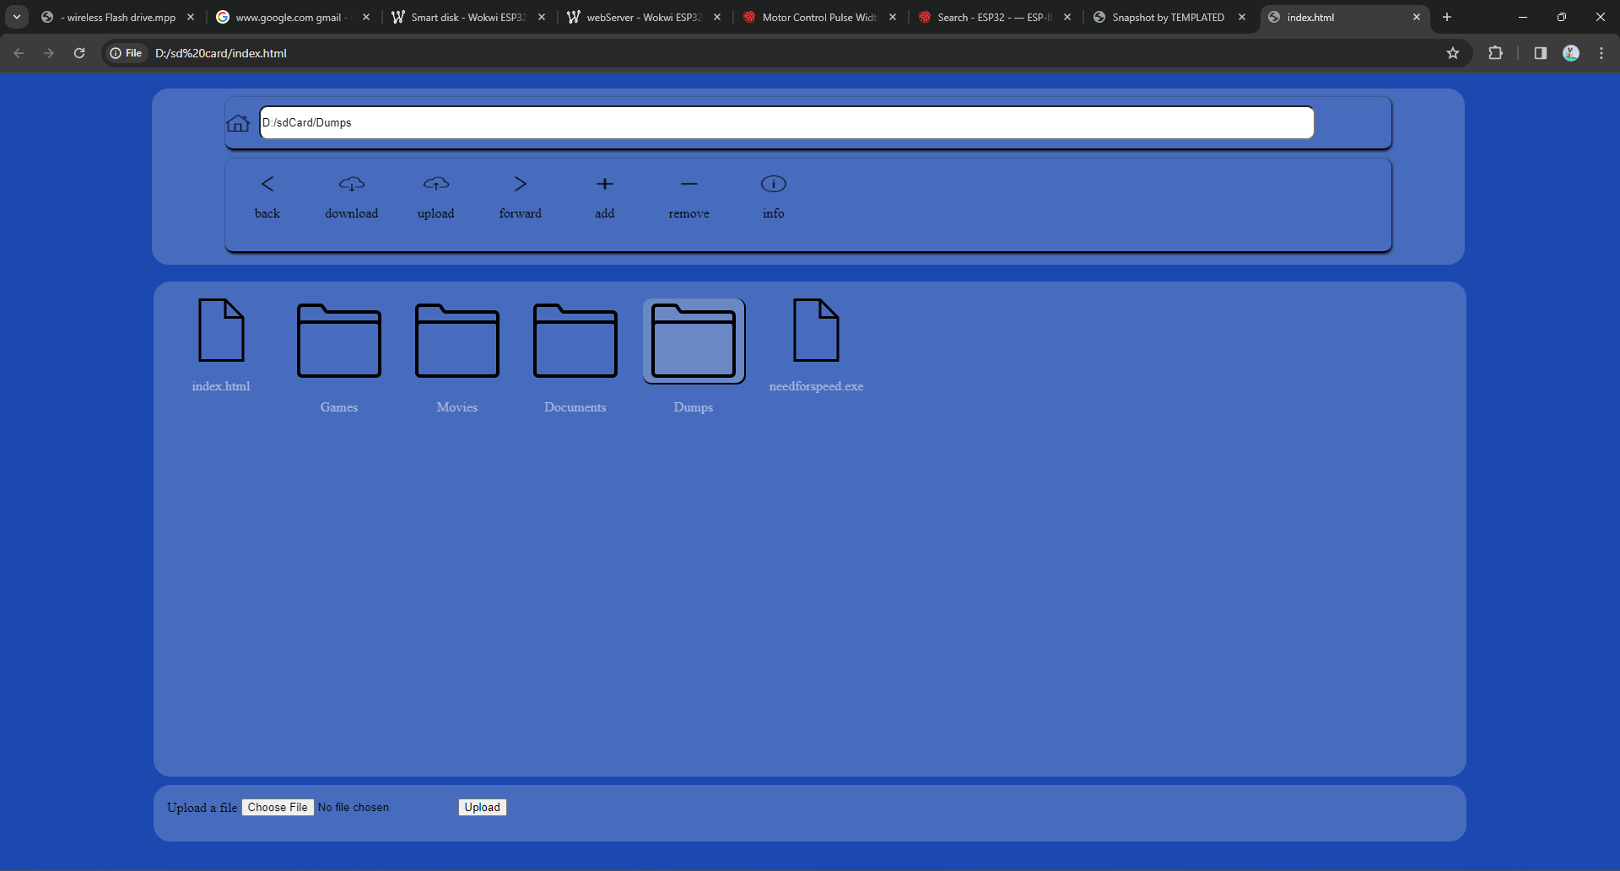
Work done so far
University of Dar es Salaam
Electronics and Telecommunications Engineering
ES 499: Final Year Project
17

Slide 19
Thank you!
University of Dar es Salaam
Electronics and Telecommunications Engineering
ES 499: Final Year Project
18

